Slide 1
Efficient Execution Plans for Distributed Skyline Query Processing
Paper by
Joao B. Rocha Junior
Akrivi Vlachou
Christos Dolkeridis

Slide 2
Efficient Execution Plans for Distributed Skyline Query Processing
The generation of efficient execution plans for skyline query processing in large-scale distributed environments.
Each server stores autonomously a fraction of the data.
Horizontal partition of data.
All servers need to process the skyline query.

Slide 3
System architecture
Each server Si can directly connect to any other server Sj.
Mesh topology.
A skyline query can be initiated by any server.
Skyline query is processed by sending the query to all servers Si.
Each server Si reports its local skyline set SKYi to originator for subsequent merging.
Notes:
Cluster
No coordinator
No specific initiator
Naïve approach

Slide 4
Dependency relation
Work on this slide
execution plan defines the order in which the individual skyline queries are processed on different servers.
A dependency between two servers means that points of the first server must dominate at least some points of the following server.
Optimizations By exploiting these dependencies.

Slide 5
General terms used
Volume of dominance area quantifies the pruning power of a data point.
enclosed dominance area of a point p, as the area within the hyper-rectangle mi that is dominated by p.
Similarly , given two hyper-rectangles mi and mj, the enclosed dominance area Vij of mi on mj is the volume of mj that is dominated by the lower left corner li of mi
The pruning power PPij of mi on mj is defined as PPij =Vij/Vj

Slide 6
General terms used
A hyper-rectangle mi(li, ui).
Given two hyper-rectangles mi and mj
(1) mi dominates mj, if ui ≺ lj;
(2) mi partially dominates mj, if li ≺ uj, but
ui ⊀ lj;
(3) mi and mj are incomparable, if li ⊀ uj and lj ⊀ ui.

Slide 7
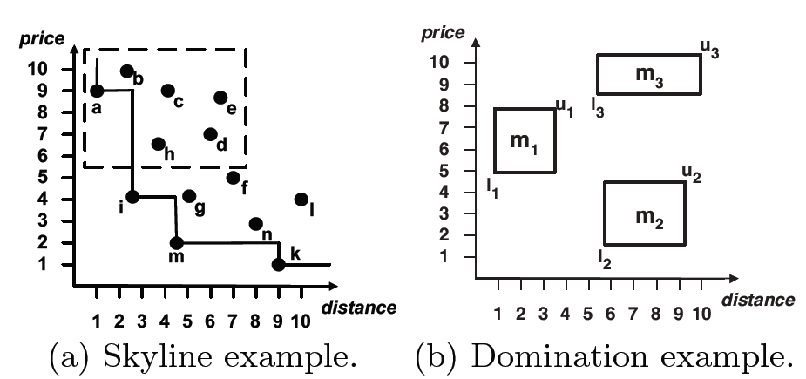
Example

Slide 8
Main phases of skyplan
Collect the MBRs of all servers.
Builds a weighted directed graph
The graph is transformed into an execution plan .

Slide 9
Collecting all the MBRs to originator
Each server Si reports a set of MBRs to Sorg .
Each MBR reported by a server Si defines a constrained skyline query on Si, where the constraints are set by the boundaries of the MBR.

Slide 10
Generation of efficient execution plan
Sorg generates an execution plan.
The non-dominated MBRs are partitioned into incomparable groups.
Each incomparable group is processed in parallel, since no gain can be achieved by filtering.
For creation of the execution plan, the Sorg first creates a sd graph.

Slide 11
Skyline dependency graph
The SD-graph is the weighted directed graph G = (N, E,w)
Each node ni ∈ N corresponds to a non-dominated MBR mi.
E is a set of ordered pairs eij = (i, j), where mi, mj are MBRs, and mi partially dominates mj .
w is a weight function defined as:
wij = |mj |/|D| *PPij ,

Slide 12
Construction of sd graph
Each non-dominated MBR mi is represented as a node (vertex) ni of the graph.
Dominated MBRs are immediately discarded,.
For each MBR mj that is partially dominated by mi, a weighted directed edge eij from node ni to nj is added.

Slide 13
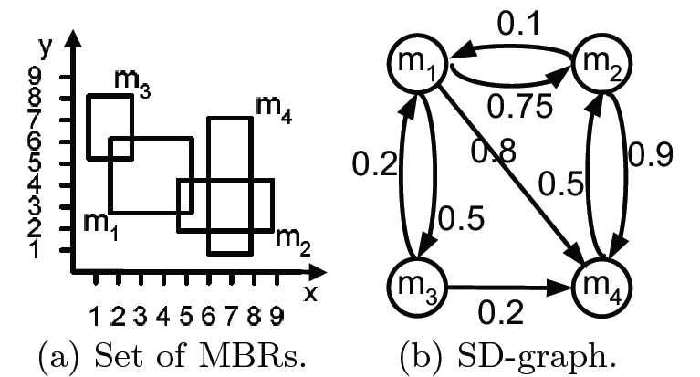

Slide 14
Quality of execution plan
The quality Q(P) of an execution plan P(N,E)
Q(P) = ∑ eij∈E wij
Thus, an execution plan Pi is better than another plan Pj in terms of quality if: Q(Pi) > Q(Pj ).

Slide 15
The problem of generating the maximum pruning execution
plan from the SD-graph is equivalent to the maximum
spanning tree problem.

